Slide 1
Uncertainty management in rule-based expert systems
Introduction, or what is uncertainty?
Basic probability theory
Bayesian reasoning
Bias of the Bayesian mesod
Certainty factors theory and evidential reasoning
Summary

Slide 2
Introduction, or what is uncertainty?
Information can be incomplete, inconsistent, uncertain, or all three. In other words, information is often unsuitable for solving a problem.
Uncertainty is defined as the lack of the exact knowledge that would enable us to reach a perfectly reliable conclusion. Classical logic permits only exact reasoning. It assumes that perfect knowledge always exists and the law of the excluded middle can always be applied:
IF A is true IF A is false
THEN A is not false THEN A is not true

Slide 3
Sources of uncertain knowledge
Weak implications. Domain experts and knowledge engineers have the painful task of establishing concrete correlations between IF (condition) and THEN (action) parts of the rules. Therefore, expert systems need to have the ability to handle vague associations, for example by accepting the degree of correlations as numerical certainty factors.

Slide 4
Imprecise language. Our natural language is ambiguous and imprecise. We describe facts with such terms as often and sometimes, frequently and hardly ever. As a result, it can be difficult to express knowledge in the precise IF-THEN form of production rules. However, if the meaning of the facts is quantified, it can be used in expert systems. In 1944, Ray Simpson asked 355 high school and college students to place 20 terms like often on a scale between 1 and 100. In 1968, Milton Hakel repeated this experiment.

Slide 5
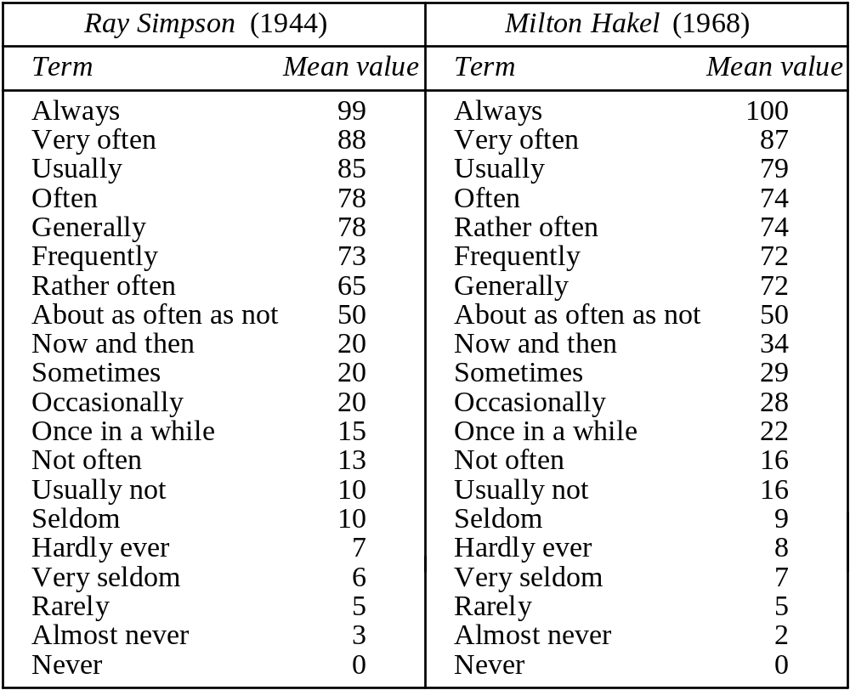
Quantification of ambiguous and imprecise terms on a time-frequency scale

Slide 6
Unknown data. When the data is incomplete or missing, the only solution is to accept the value “unknown” and proceed to an approximate reasoning with this value.
Combining the views of different experts. Large expert systems usually combine the knowledge and expertise of a number of experts. Unfortunately, experts often have contradictory opinions and produce conflicting rules. To resolve the conflict, the knowledge engineer has to attach a weight to each expert and then calculate the composite conclusion. But no systematic method exists to obtain these weights.

Slide 7
Basic probability theory
The concept of probability has a long history that goes back thousands of years when words like “probably”, “likely”, “maybe”, “perhaps” and “possibly” were introduced into spoken languages. However, the mathematical theory of probability was formulated only in the 17th century.
The probability of an event is the proportion of cases in which the event occurs. Probability can also be defined as a scientific measure of chance.

Slide 8
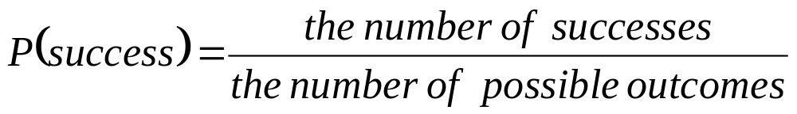
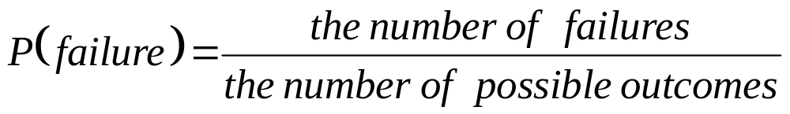
Probability can be expressed mathematically as a numerical index with a range between zero (an absolute impossibility) to unity (an absolute certainty).
Most events have a probability index strictly between 0 and 1, which means that each event has at least two possible outcomes: favourable outcome or success, and unfavourable outcome or failure.

Slide 9
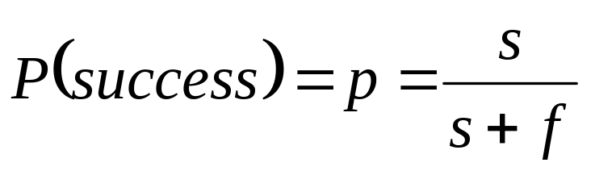
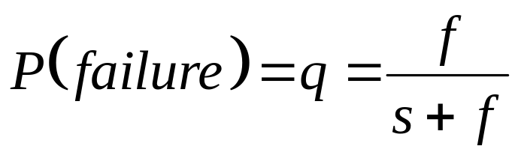
If s is the number of times success can occur, and f is the number of times failure can occur, then
and p + q = 1
If we throw a coin, the probability of getting a head will be equal to the probability of getting a tail. In a single throw, s = f = 1, and therefore the probability of getting a head (or a tail) is 0.5.

Slide 10
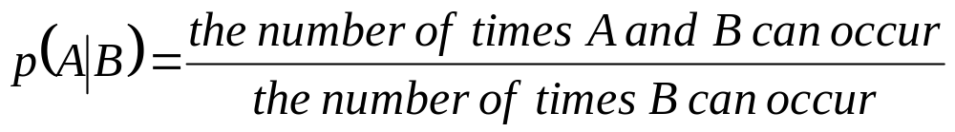
Conditional probability
Let A be an event in the world and B be another event. Suppose that events A and B are not mutually exclusive, but occur conditionally on the occurrence of the other. The probability that event A will occur if event B occurs is called the conditional probability. Conditional probability is denoted mathematically as p(A|B) in which the vertical bar represents GIVEN and the complete probability expression is interpreted as “Conditional probability of event A occurring given that event B has occurred”.

Slide 11
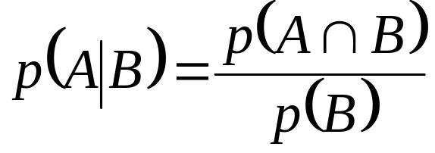
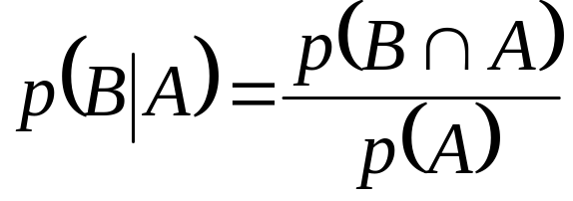
The number of times A and B can occur, or the probability that both A and B will occur, is called the joint probability of A and B. It is represented mathematically as p(A∩B). The number of ways B can occur is the probability of B, p(B), and thus
Similarly, the conditional probability of event B occurring given that event A has occurred equals

Slide 12
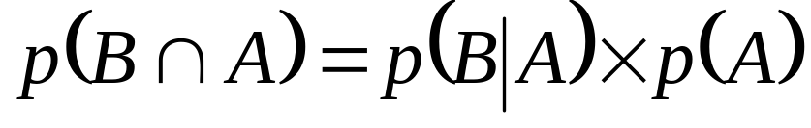
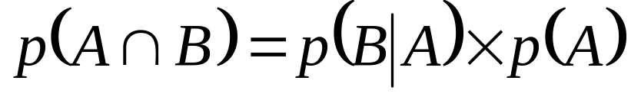
Hence,
and
Substituting the last equation into the equation
yields the Bayesian rule:

Slide 13
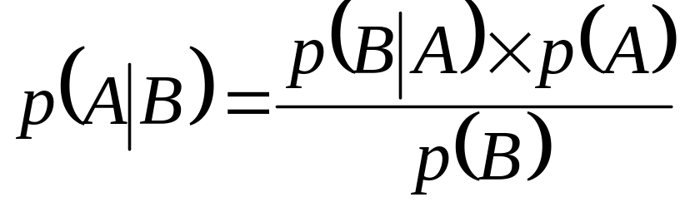
Bayesian rule
    where:
    p(A|B) is the conditional probability that event A occurs given that event B has occurred;
    p(B|A) is the conditional probability of event B occurring given that event A has occurred;
    p(A) is the probability of event A occurring;
    p(B) is the probability of event B occurring.

Slide 14
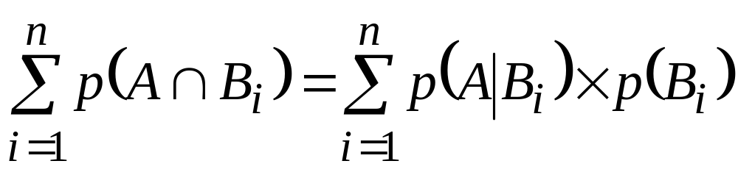
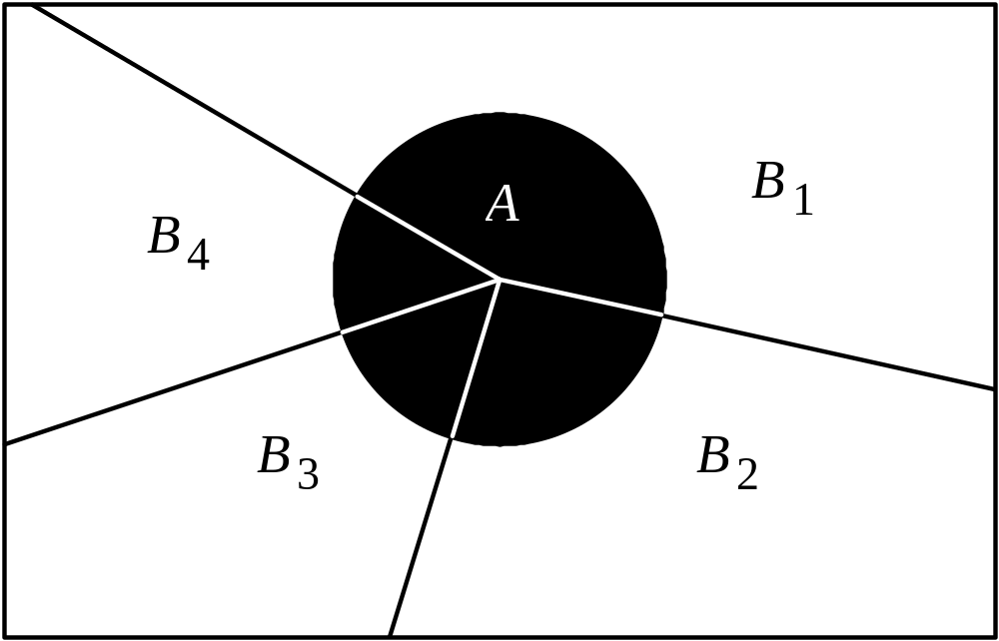
The joint probability

Slide 15
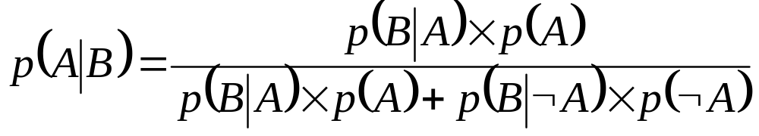
If the occurrence of event A depends on only two
mutually exclusive events, B and NOT B, we obtain:
where ¬ is the logical function NOT.
Similarly,
Substituting this equation into the Bayesian rule yields:

Slide 16
Bayesian reasoning
Suppose all rules in the knowledge base are
represented in the following form:
IF H is true
THEN E is true {with probability p}
This rule implies that if event H occurs, then the
probability that event E will occur is p.
In expert systems, H usually represents a hypothesis
and E denotes evidence to support this hypothesis.

Slide 17
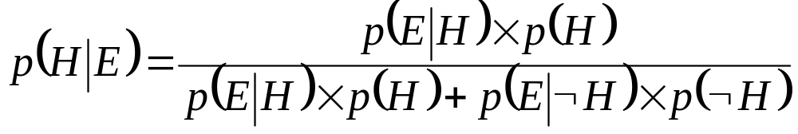
The Bayesian rule expressed in terms of hypotheses
and evidence looks like this:
where:
p(H) is the prior probability of hypothesis H being true;
p(E|H) is the probability that hypothesis H being true will result in evidence E;
p(¬H) is the prior probability of hypothesis H being false;
p(E|¬H) is the probability of finding evidence E even when hypothesis H is false.

Slide 18
In expert systems, the probabilities required to solve a problem are provided by experts. An expert determines the prior probabilities for possible hypotheses p(H) and p(¬H), and also the conditional probabilities for observing evidence E if hypothesis H is true, p(E|H), and if hypothesis H is false, p(E|¬H).
Users provide information about the evidence observed and the expert system computes p(H|E) for hypothesis H in light of the user-supplied evidence E. Probability p(H|E) is called the posterior probability of hypothesis H upon observing evidence E.

Slide 19
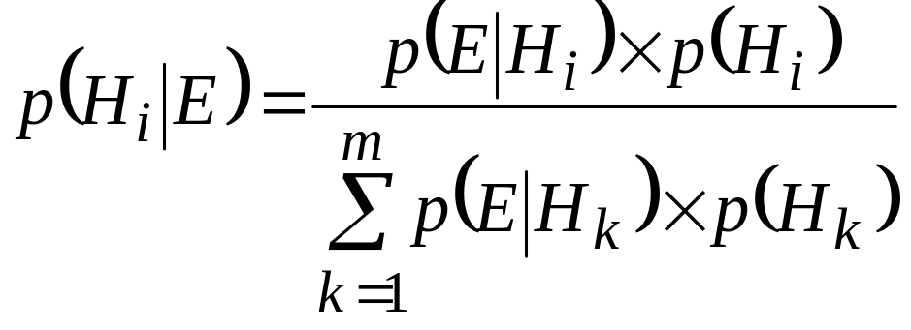
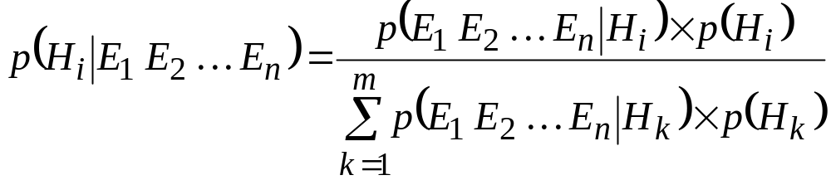
We can take into account both multiple hypotheses H₁, H₂,..., H_{m} and multiple evidences E₁, E₂,..., E_{n}. The hypotheses as well as the evidences must be mutually exclusive and exhaustive.
Single evidence E and multiple hypotheses follow:
Multiple evidences and multiple hypotheses follow:

Slide 20
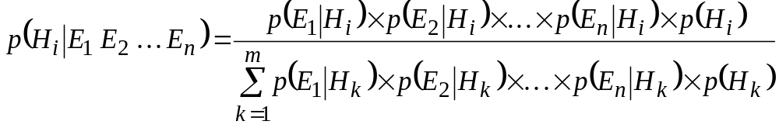
This requires to obtain the conditional probabilities of all possible combinations of evidences for all hypotheses, and thus places an enormous burden on the expert.
Therefore, in expert systems, conditional independence among different evidences assumed. Thus, instead of the unworkable equation, we attain:

Slide 21
Ranking potentially true hypotheses
Let us consider a simple example.
Suppose an expert, given three conditionally independent evidences E₁, E₂ and E₃, creates three mutually exclusive and exhaustive hypotheses H₁, H₂ and H₃, and provides prior probabilities for these hypotheses – p(H₁), p(H₂) and p(H₃), respectively. The expert also determines the conditional probabilities of observing each evidence for all possible hypotheses.

Slide 22
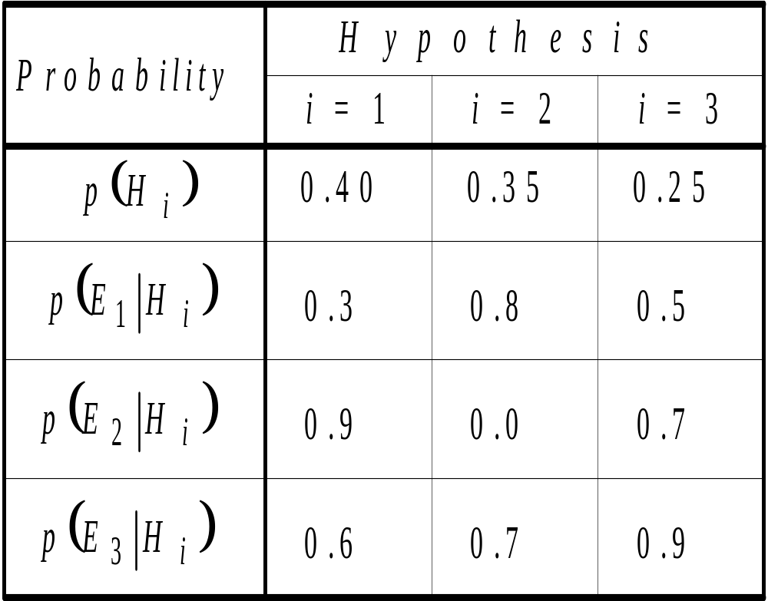
The prior and conditional probabilities
Assume that we first observe evidence E₃. The expert system computes the posterior probabilities for all hypotheses as

Slide 23
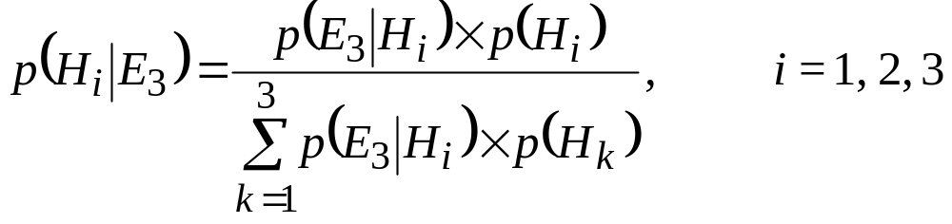
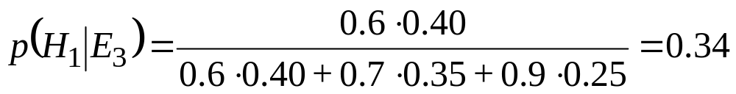
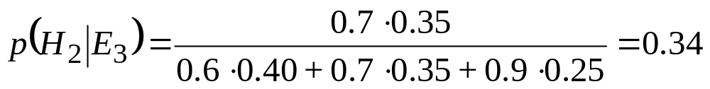
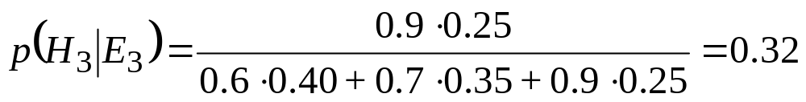
Thus,
After evidence E₃ is observed, belief in hypothesis H₂ increases and becomes equal to belief in hypothesis H₁. Belief in hypothesis H₃ also increases and even nearly reaches beliefs in hypotheses H₁ and H₂.

Slide 24
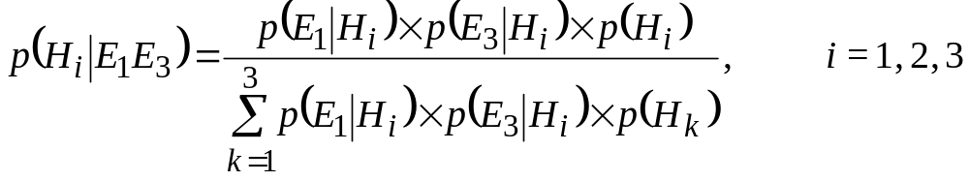
Suppose now that we observe evidence E₁. The posterior probabilities are calculated as
Hence,
Hypothesis H₂ has now become the most likely one.

Slide 25
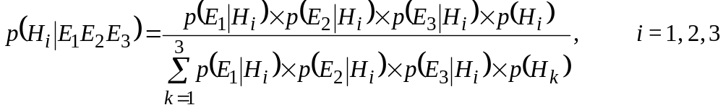
After observing evidence E₂, the final posterior probabilities for all hypotheses are calculated:
Although the initial ranking was H₁, H₂ and H₃, only hypotheses H₁ and H₃ remain under consideration after all evidences (E₁, E₂ and E₃) were observed.

Slide 26
Bias of the Bayesian Method
The framework for Bayesian reasoning requires probability values as primary inputs. The assessment of these values usually involves human judgement. However, psychological research shows that humans either cannot elicit probability values consistent with the Bayesian rules.
This suggests that the conditional probabilities may be inconsistent with the prior probabilities given by the expert.

Slide 27
Consider, for example, a car that does not start and makes odd noises when you press the starter. The conditional probability of the starter being faulty if the car makes odd noises may be expressed as:
IF the symptom is “odd noises”
THEN the starter is bad {with probability 0.7}
Consider, for example, a car that does not start and makes odd noises when you press the starter. The conditional probability of the starter being faulty if the car makes odd noises may be expressed as:
p(starter is not bad|odd noises) =
= p(starter is good|odd noises) = 1−0.7 = 0.3

Slide 28
Therefore, we can obtain a companion rule that states
IF the symptom is “odd noises”
THEN the starter is good {with probability 0.3}
Domain experts do not deal with conditional probabilities and often deny the very existence of the hidden implicit probability (0.3 in our example).
We would also use available statistical information and empirical studies to derive the following rules:
IF the starter is bad
THEN the symptom is “odd noises” {probability 0.85}
IF the starter is bad
THEN the symptom is not “odd noises” {probability 0.15}

Slide 29
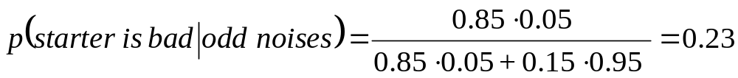
To use the Bayesian rule, we still need the prior probability, the probability that the starter is bad if the car does not start. Suppose, the expert supplies us the value of 5 per cent. Now we can apply the Bayesian rule to obtain:
The number obtained is significantly lower than the expert’s estimate of 0.7 given at the beginning of this section.
The reason for the inconsistency is that the expert made different assumptions when assessing the conditional and prior probabilities.

Slide 30
Certainty factors theory and evidential reasoning
Certainty factors theory is a popular alternative to Bayesian reasoning.
A certainty factor (cf ), a number to measure the expert’s belief. The maximum value of the certainty factor is, say, +1.0 (definitely true) and the minimum −1.0 (definitely false). For example, if the expert states that some evidence is almost certainly true, a cf value of 0.8 would be assigned to this evidence.

Slide 31
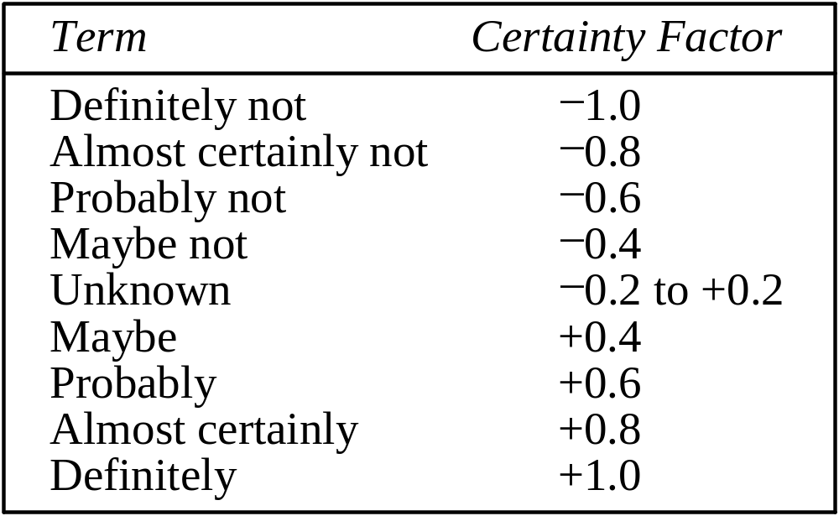
Uncertain terms and their
interpretation in MYCIN

Slide 32
In expert systems with certainty factors, the knowledge base consists of a set of rules that have the following syntax:
IF <evidence>
THEN <hypothesis> {cf }
where cf represents belief in hypothesis H given that evidence E has occurred.

Slide 33
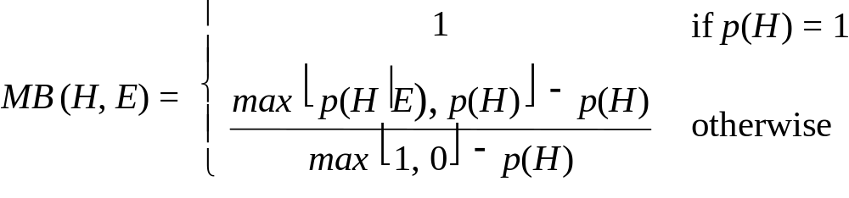

The certainty factors theory is based on two functions: measure of belief MB(H,E), and measure of disbelief MD(H,E).
p(H) is the prior probability of hypothesis H being true;
p(H|E) is the probability that hypothesis H is true given evidence E.

Slide 34
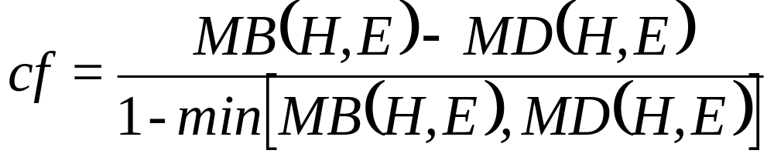
The values of MB(H, E) and MD(H, E) range between 0 and 1. The strength of belief or disbelief in hypothesis H depends on the kind of evidence E observed. Some facts may increase the strength of belief, but some increase the strength of disbelief.
The total strength of belief or disbelief in a hypothesis:

Slide 35
Example:
Consider a simple rule:
IF A is X
THEN B is Y
An expert may not be absolutely certain that this rule holds. Also suppose it has been observed that in some cases, even when the IF part of the rule is satisfied and object A takes on value X, object B can acquire some different value Z.
IF A is X
THEN B is Y {cf 0.7};
B is Z {cf 0.2}

Slide 36
The certainty factor assigned by a rule is propagated through the reasoning chain. This involves establishing the net certainty of the rule consequent when the evidence in the rule antecedent is uncertain:
cf (H,E) = cf (E) × cf
For example,
IF sky is clear
THEN the forecast is sunny {cf 0.8}
and the current certainty factor of sky is clear is 0.5, then
cf (H,E) = 0.5 ⋅ 0.8 = 0.4
This result can be interpreted as “It may be sunny”.

Slide 37
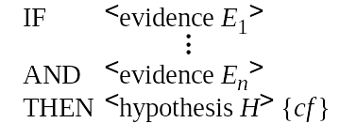
For conjunctive rules such as
the certainty of hypothesis H, is established as follows:
cf (H,E₁∩E₂∩...∩E_{n}) = min [cf (E₁), cf (E₂),..., cf (E_{n})] × cf
For example,
IF sky is clear
AND the forecast is sunny
THEN the action is ‘wear sunglasses’ {cf 0.8}
and the certainty of sky is clear is 0.9 and the certainty of the forecast of sunny is 0.7, then
cf (H,E₁∩E₂) = min [0.9, 0.7] ⋅ 0.8 = 0.7 ⋅ 0.8 = 0.56

Slide 38
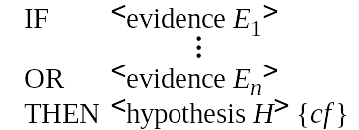
For disjunctive rules such as
the certainty of hypothesis H, is established as follows:
cf (H,E₁∪E₂∪...∪E_{n}) = max [cf (E₁), cf (E₂),..., cf (E_{n})] × cf
For example,
IF sky is overcast
OR the forecast is rain
THEN the action is ‘take an umbrella’ {cf 0.9}
and the certainty of sky is overcast is 0.6 and the certainty of the forecast of rain is 0.8, then
cf (H,E₁∪E₂) = max [0.6, 0.8] ⋅ 0.9 = 0.8 ⋅ 0.9 = 0.72

Slide 39
When the same consequent is obtained as a result of the execution of two or more rules, the individual certainty factors of these rules must be merged to give a combined certainty factor for a hypothesis.
Suppose the knowledge base consists of the following rules:
Rule 1: IF A is X
THEN C is Z {cf 0.8}
Rule 2: IF B is Y
    THEN C is Z {cf 0.6}
What certainty should be assigned to object C having value Z if both Rule 1 and Rule 2 are fired?

Slide 40
Common sense suggests that, if we have two pieces of evidence (A is X and B is Y) from different sources (Rule 1 and Rule 2) supporting the same hypothesis (C is Z), then the confidence in this hypothesis should increase and become stronger than if only one piece of evidence had been obtained.

Slide 41
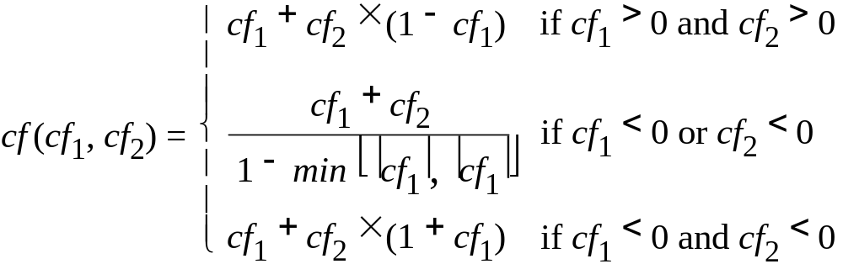
To calculate a combined certainty factor we can use the following equation:
where:
cf₁ is the confidence in hypothesis H established by Rule 1;
cf₂ is the confidence in hypothesis H established by Rule 2;
|cf₁| and |cf₂| are absolute magnitudes of cf₁ and cf₂, respectively.

Slide 42
The certainty factors theory provides a practical alternative to Bayesian reasoning. The heuristic manner of combining certainty factors is different from the manner in which they would be combined if they were probabilities. The certainty theory is not “mathematically pure” but does mimic the thinking process of a human expert.

Slide 43
Comparison of Bayesian reasoning and certainty factors
Probability theory is the oldest and best-established technique to deal with inexact knowledge and random data. It works well in such areas as forecasting and planning, where statistical data is usually available and accurate probability statements can be made.

Slide 44
However, in many areas of possible applications of expert systems, reliable statistical information is not available or we cannot assume the conditional independence of evidence. As a result, many researchers have found the Bayesian method unsuitable for their work. This dissatisfaction motivated the development of the certainty factors theory.
Although the certainty factors approach lacks the mathematical correctness of the probability theory, it appears to outperform subjective Bayesian reasoning in such areas as diagnostics, particularly in medicine.

Slide 45
Certainty factors are used in cases where the probabilities are not known or are too difficult or expensive to obtain. The evidential reasoning mechanism can manage incrementally acquired evidence, the conjunction and disjunction of hypotheses, as well as evidences with different degrees of belief.
The certainty factors approach also provides better explanations of the control flow through a rule-based expert system.

Slide 46
The Bayesian method is likely to be the most appropriate if reliable statistical data exists, the knowledge engineer is able to lead, and the expert is available for serious decision-analytical conversations.
In the absence of any of the specified conditions, the Bayesian approach might be too arbitrary and even biased to produce meaningful results.
The Bayesian belief propagation is of exponential complexity, and thus is impractical for large knowledge bases.

